Slide 1
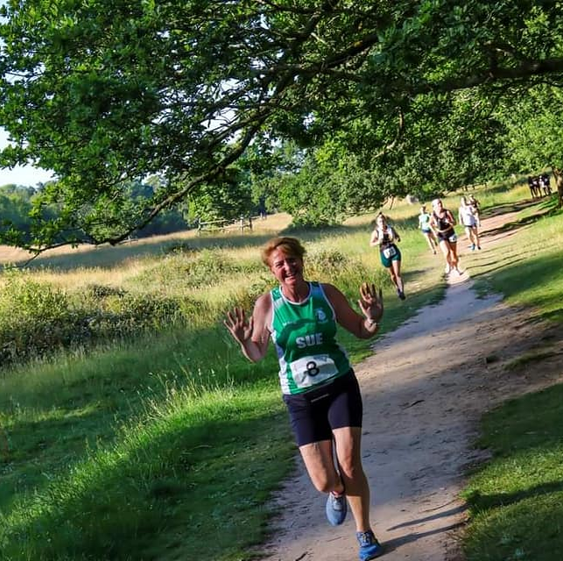
Sue Bayes https://www.linkedin.com/in/suebayes/
Independent Power BI developer
Own business
Time is important
Data Platform MVP
www.databayes.co.uk
https://www.meetup.com/devon-and-cornwall-power-bi-meetup-group/
Notes:
Who – where from?
Have you used Tabular Editor?

Slide 3
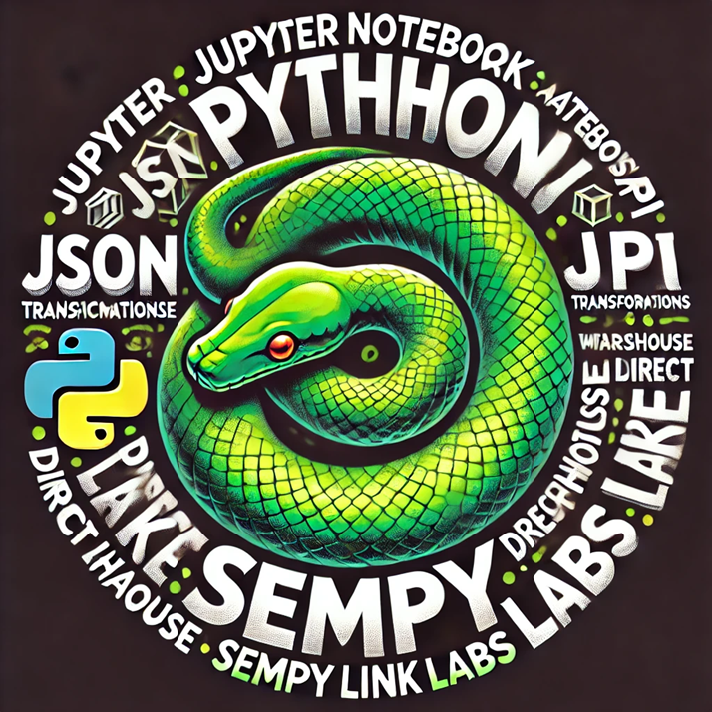
Python in Fabric
jupyter notebook
python
json
api
transformations
lakehouses
warehouse
direct lake
sempy
sempy link labs
organisation apps

Slide 4
Resources
https://learn.microsoft.com/en-us/fabric/data-science/semantic-link-overview
https://developer.garmin.com/gc-developer-program/activity-api/
https://pypi.org/project/garminconnect/
https://github.com/m-kovalsky/semantic-link-labs
https://github.com/stephbruno

